Slide 1
Sprint 8
Team 9

Slide 2
Summary
Finished Jeopardy!
Major redesign changes (SASS)

Slide 3
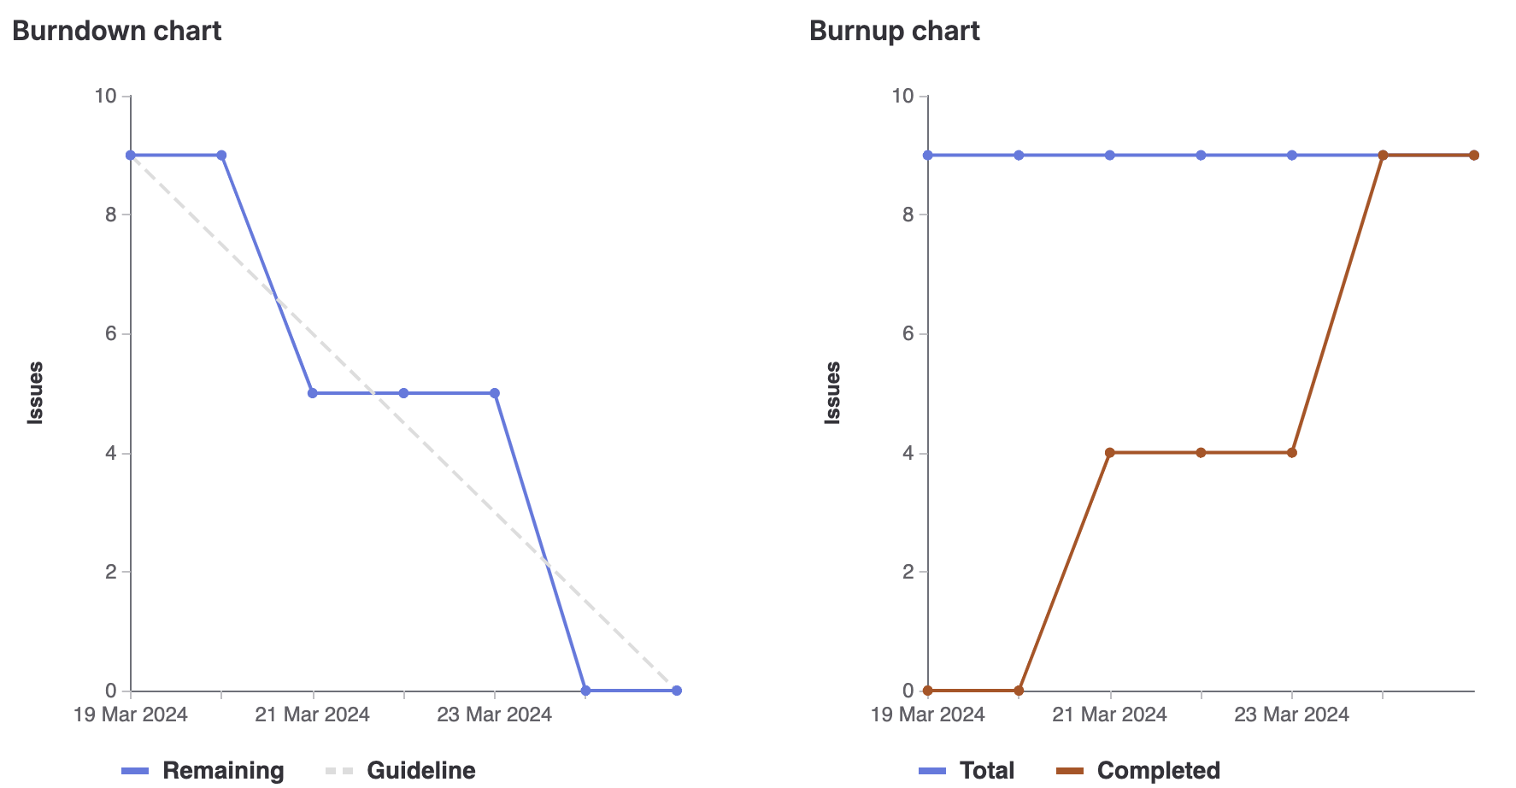
Burn Down

Slide 4
Eric (Team Lead)
Bootstrap SASS visual improvements
Jeopardy front end Implementation
Bug fixes
Weights: 12

Slide 5
Cavaari Taylor
SASS research
Visual Improvements to chat page and Carousel
Bug fixes
Total weights: 12

Slide 6
Egor
Bootstrap SASS light/dark themes
Visual Improvements to UI
Jeopardy! Front-end Implementation
Bug fixes
Weight: 12

Slide 7
Tehreem
SASS Research
Redesign of the Main page, About me and Games Page
Created Visuals for Main and Games Pages
Jeopardy Bug Fixing
Total Weights: 12

Slide 8
Karina
SASS research
Visual improvements on all pages
Finished front-end for Jeopardy
Total Weights: 12

Slide 9
Muhammad
Helped with Jeopardy game and redesigning chat page
Visual improvements and aided in bug fixes
Total weights: 12

Slide 10
Kalindu
Jeopardy page implementation
Wordle additional logic
Bug fixes
Total weight: 12

Slide 11
Reflection
What went well:
Sprint Planning and general Implementation
What didn't go well:
Communication between sub-teams
What we will do better:
Communicate and be more transparent on task completion

Slide 12
DEMO!

